Slide 1
Future State
Model Driven
Services Management
Extending Integration & DAG’s Operational Model using KGs

Slide 2
Strategy
Map
Value Planning
Value Creation
Initiative
Prioritization
Capability
Map
Policy
Risk
Operations
(Services)
Requirements
Stakeholder
Demand
Value Measurement
Value Delivery
Story
(Agile)
Scenario
Value Planning Model

Slide 3
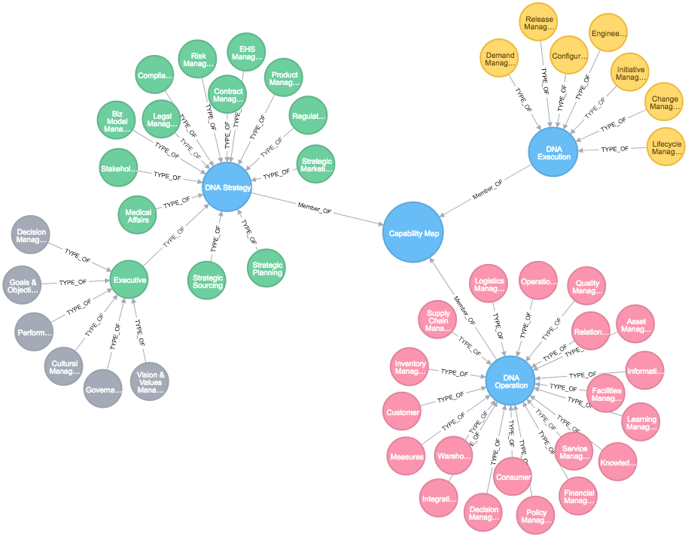
Service Planning Model (Future State)
Value Chain
Inspect Transmission Tower
Impacted Services & Capabilities
Capabilities
Tower Inspection (L3)
OPS Maintenance (L2)
OPS Support (L1)
Data Objects
Asset Ref Model
Item & Parts Assembly
Issue / Defect
Stakeholders
Mapping impact across Strategy, Operations, & Execution (PPM)
Business Objects
Policy (numerous…)
Maintenance Manuals
Service / Task Tickets
Schedule & Projects
Measures
Commitments
Scheduling
Customer Impact
Upsell Opportunities
Models
Predictive Failure
Repair / Replace
Capacity Optimization
Resource Utilization
Data Objects
Biz Objects
Measures
Processes
Processes & Rules
Schedule Main. slot
Schedule Maint. resources
Access Stakeholder Info
Update Service info
Scope of Work for Initiative Planning and Execution

Slide 4
Governance Framework for Service Delivery
Structures
Ontologies
  Concepts, Content, Change
  Context, Relationships
Taxonomies
  Enterprise Glossary
Enterprise
Data
Scenarios
Context
  Relationships
  Properties
  Lifecycle (change)
  Lineage
Semantics
Local Glossaries
Domain-Specific
Services
Integration & Sourcing
Search (Boolean, NLP)
Analytics (Quality, Insights)
Visualization (Navigation)
Integrity & Security
Publishing (APIs, Data Sets)
Auditing & Utilization
Shared Services
Future goal is to capture and align all content & context while preserving meaning, perspective, and state of change

Slide 5

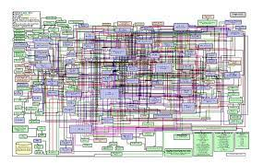
Organic Solution
(Simplifying Search, Discovery, & Insights)
Knowledge Graphs provide a scaffolding that sits atop existing systems.
Notes:
‹#›

Slide 6
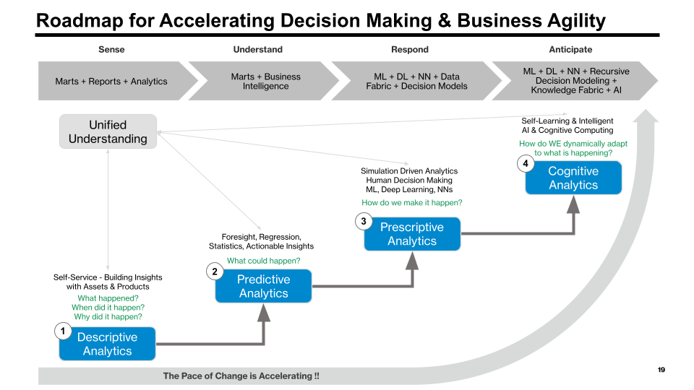
Knowledge-Driven Governance
now we can “link” changes to any artifact (doc, code, service, outcome, feature, use case, design specification, SOP) to any other artifact within IT, across our data, across the business.
Understanding the impact of change is the first step towards managing and responding to change at the speed of business.
Notes:
‹#›

Slide 7
Key Benefits of KG adoption
Combines Conceptual & Logical Views of data
Preserves enterprise and community perspectives of “truth”
Shifts spend on fixing existing problems so we can solve new ones
Increases adaptability and resiliency for consumers of data & information
Provides unlimited scale to manage volume and complexity
Integrates the lifecycle and operational management (systems, products, services, data, analytics)
Provides a foundation for designing and managing Digital Twins while improving AI and leveraging ML for knowledge capture & consumption
Accelerates innovation and cycle time delivery for new products & services
Notes:
‹#›

Slide 8
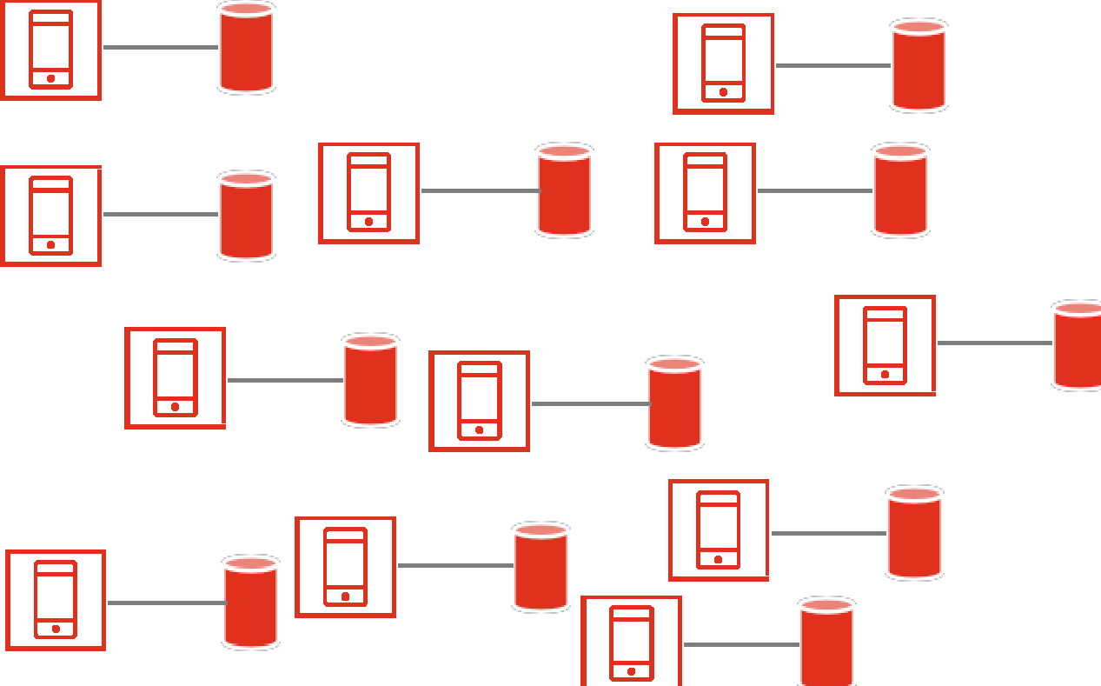

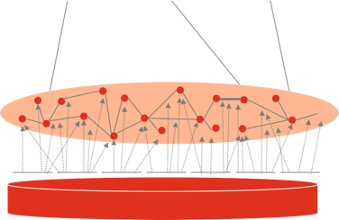
Services built around application data using fixed perspectives & semantics
Shift from app-centric to
data-centric value delivery
Services built around business need & semantics

Slide 9
Advantages of embracing KGs
The 4Ds
  De-Silo
    Integrate all the relevant sources in a declarative fashion that enables reuse, cross-enterprise scalability, and continuous refinement.
  Disambiguate
    Disambiguate: Triangulate using set theory and linguistic description logic in addition to statistical methods, enabling precise entity resolution.
  Detect
    Detect: Uncover weaker signals by articulating the most relevant and distant relationships between entities, via richer contextualization.
  Discover
    Discover: Radically expand the ability to discover insights, moving beyond keywords to concepts.

Slide 10
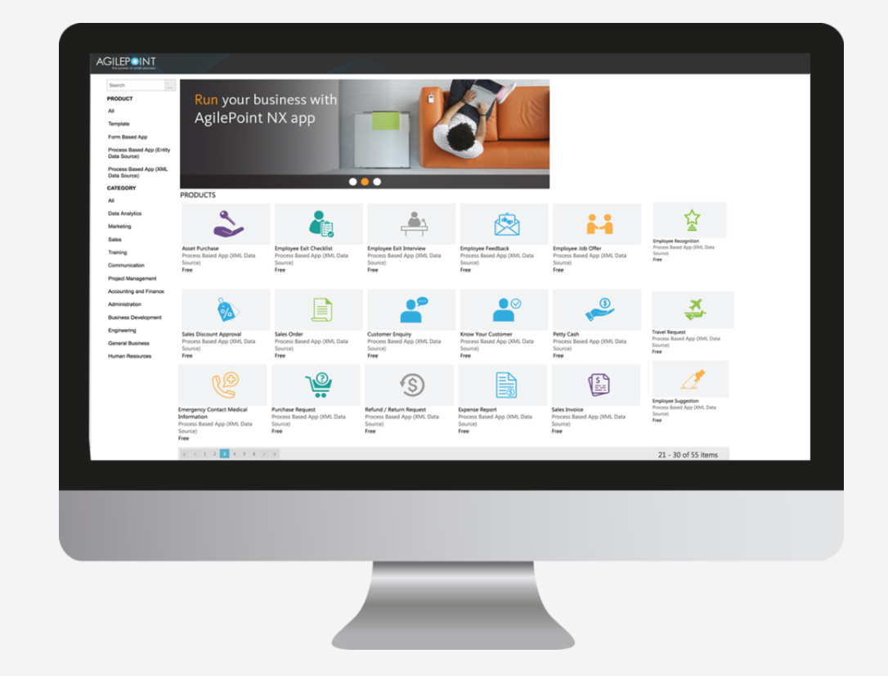
Towards a Future State of Self Sufficiency
Self sufficient process automation built atop a set of published libraries:
    Process (Activity) Components
    Data Services (1)
    Integration Services (2)
    Event Management Services (3)
    Deployment Services
    Reporting & Analytic Services
    Data management, data quality, data transforms, semantic matching
    Data and Process integration with loose coupling, highly available, with ability to deliver QoS to address scale & quality
    Manually triggered workflow, timed events, and automatically triggered activities
‹#›

